Slide 1
Java JVM, JDK and JRE

Slide 2
Java virtual Machine(JVM)
Java virtual Machine(JVM) provides runtime environment to execute java byte code.
Is an abstract machine.
The JVM doesn't understand normal English lang, that's why we compile our *.java files to obtain *.class files that contain the bytecodes understandable by the JVM.

Slide 3
Important features of JVM are
It enables to run applications in a cloud environment or in our device.
Converts byte code to machine-specific code.
Provides basic java functions like memory management, security, garbage collection, and more.
JVM runs the program by using libraries and files given by the Java Runtime Environment.

Slide 4
JDK and JRE both contain Java Virtual Machine.
It can execute the java program line by line hence it is also called an interpreter.
JVM is easily customizable for example, we can allocate minimum and maximum memory to it.
It is independent of hardware and the operating system. So, we can write a java program once and run it anywhere.

Slide 5
The JVM performs following operation:
Loads code
Verifies code
Executes code
Provides runtime environment( in which a program or application is executed)

Slide 6
JVM Architecture

Slide 7
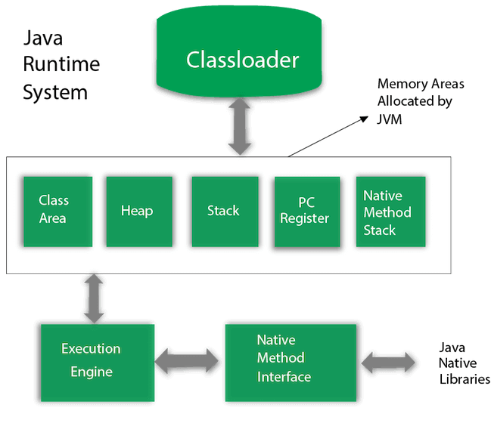

Slide 8
Class Loader : Class loader loads the Class for execution.
class area : Stores pre-class structure as constant pool.
Heap : Heap is a memory area in which objects are allocated.
Stack : It holds local variables and partial results, and plays a part in method invocation and return.

Slide 9
Program register : Program register holds the address of JVM instruction currently being executed.
Native method stack : It contains all the native methods used in the application.
Executive Engine : Execution engine controls the execute of instructions contained in the methods of the classes.
Native Method Interface : Native method interface gives an interface between java code and native code during execution.
Native Method Libraries : Native Libraries consist of files required for the execution of native code.

Slide 10
native method
A native method in Java is a method whose implementation is written in other languages such as c and c++.
The ‘native’ keyword is used before a method to indicate that it is implemented in other language.

Slide 11
We can use native method to
Implement an interface with system calls or libraries written in other programming languages
Access system or hardware resources that are only reachable from the other language
Integrate already existing code written in C/C++ into a java application

Slide 12
JRE (Java Runtime Environment)

Slide 13
JRE (Java Runtime Environment)
Used to provide a runtime environment.
Is the implementation of JVM.
Contains a set of libraries + other files that JVM uses at runtime

Slide 14
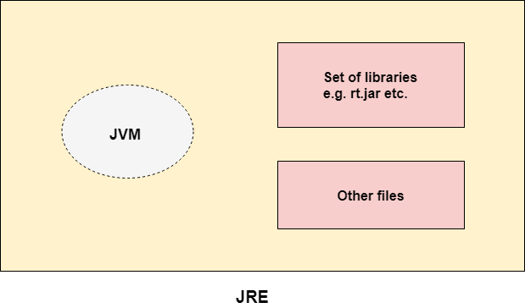

Slide 15
JDK( Java Development Kit)

Slide 16
JDK( Java Development Kit)
Is a software development environment which is used to develop java applications and applets.
It contains jre + development tools.

Slide 17
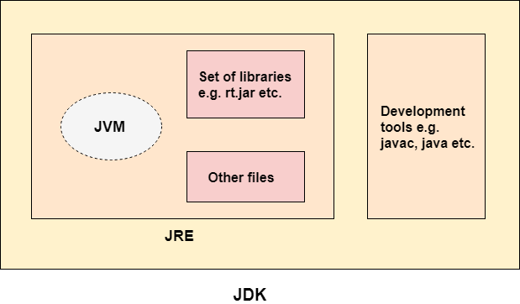

Slide 18
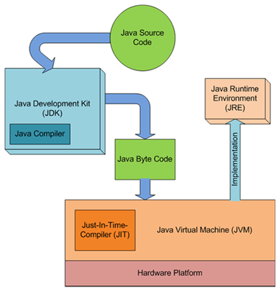
The workflow of JDK, JVM, and JRE :

Slide 19
Just-In-Time Compiler(JIT) : It is used to increase the efficiency of an interpreter.

Slide 20
Differences between interpreter and compiler

Slide 21
Interpreter | Compiler
Interpreter translates just one statement of the program at a time into machine code. | Compiler scans the entire program and translates the whole of it into machine code at once.
An interpreter takes very less time to analyze the source code. However, the overall time to execute the process is much slower. | A compiler takes a lot of time to analyze the source code. However, the overall time taken to execute the process is much faster.
It does not convert source code into object code instead it scans it line by line | It converts the source code into object code.
Keeps translating the program continuously till the first error is confronted. If any error is spotted, it stops working and hence debugging becomes easy. | A compiler generates the error message only after it scans the complete program and hence debugging is relatively harder while working with a compiler.
Interpreters are used by programming languages like Ruby and Python for example. | Compliers are used by programming languages like C and C++ for example.

